Slide 1
Support Vector Machines
Prof. Pedram

Slide 2
Topics
GEOMETRIC INTUITION
MATHEMATICAL DERIVATION
WHY WE TAKE +1 AND -1 FOR SUPPORT VECTOR PLANES
LOSS FUNCTION(HINGE LOSS) INTERPRETATION
DUAL FORM OF SVM
KERNEL TRICK FOR SVM
POLYNOMIAL KERNEL
RADIAL BASIS FUNCTION KERNEL (RBF)
SVM REGRESSION

Slide 3
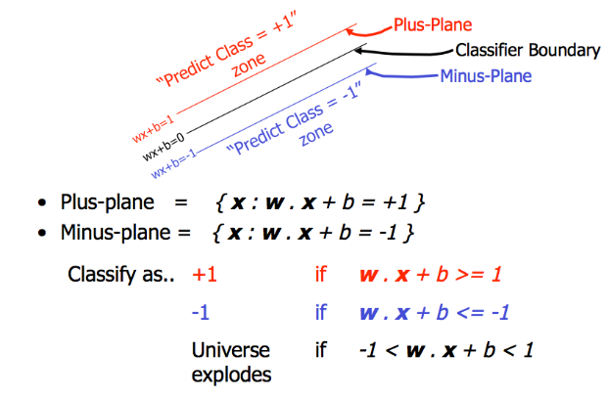
Geometric Intuition

Slide 4
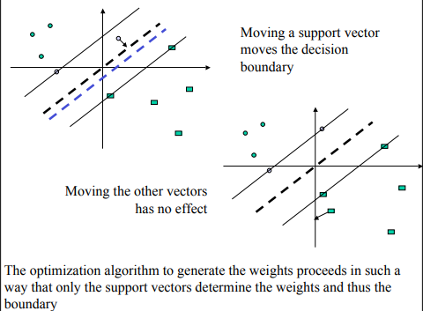

We never said that $\left\|w\right\|$= 1, because otherwise this won’t be a margin maximising problem.
Let,
$π : w^{T}x+b=0$
$π^{+ }: w^{T}x+b=1$
$π^{− }: w^{T}x+b=−1$

Slide 5
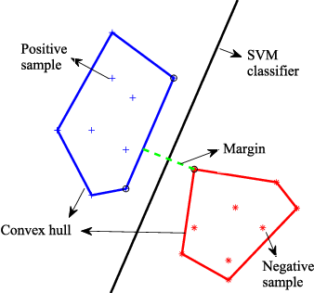
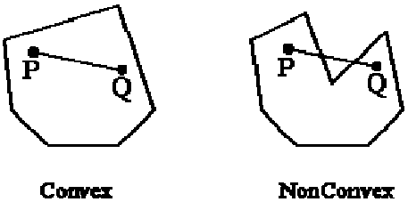
Alternative Geometric intuition
Steps
Create convex hulls for +ve and -ve points.
Find shortest line connecting these hulls
Bisect the line

Slide 6
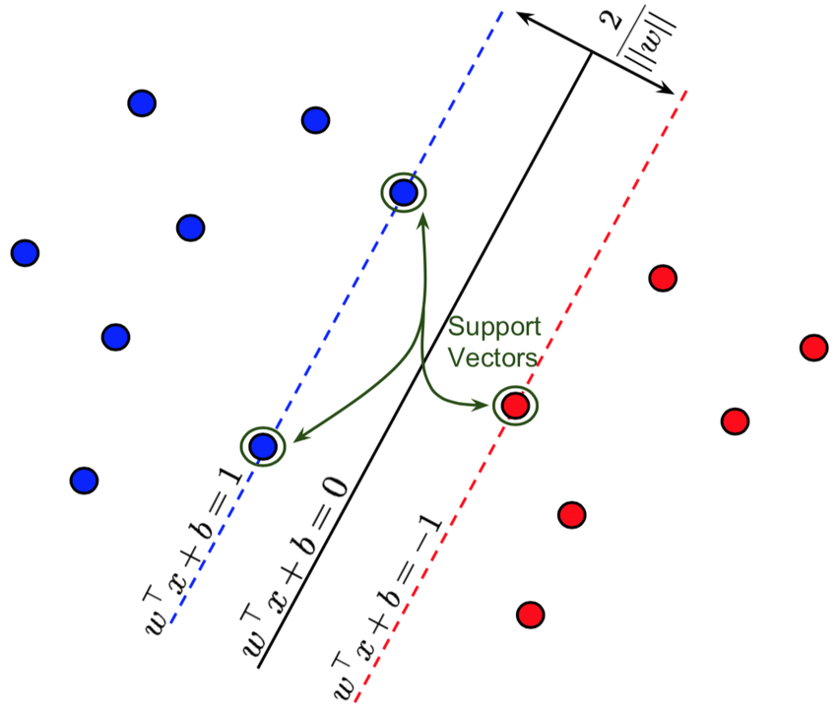
Mathematical Derivation

Slide 7
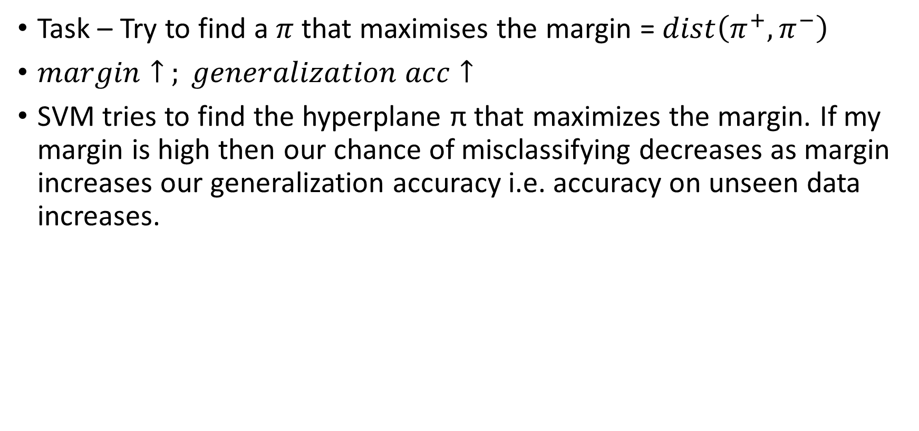
Task – Try to find a $π$that maximises the margin = $dist\left(π^{+}, π^{−}\right)$
$margin↑ ; generalization acc↑$
SVM tries to find the hyperplane π that maximizes the margin. If my margin is high then our chance of misclassifying decreases as margin increases our generalization accuracy i.e. accuracy on unseen data increases.

Slide 8
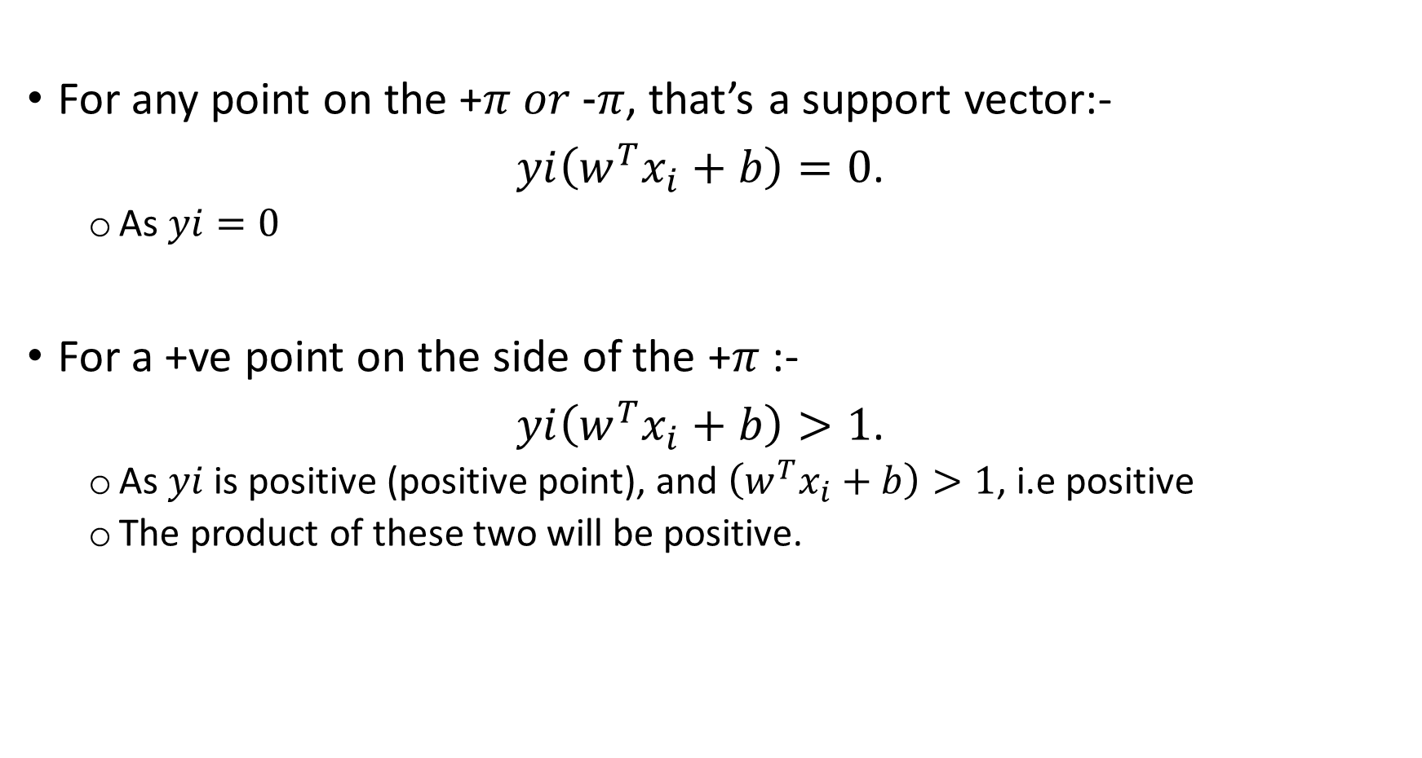
For any point on the +$π or\text{ −}π$, that’s a support vector:-
$yi\left(w^{T}x_{i}+b\right)=0$.
As $yi=0$
For a +ve point on the side of the +$π$ :-
$yi\left(w^{T}x_{i}+b\right)>1$.
As $yi$is positive (positive point), and $\left(w^{T}x_{i}+b\right)>1$, i.e positive
The product of these two will be positive.

Slide 9

For a -ve point on the side of the -$π$ :-
$yi\left(w^{T}x_{i}+b\right)<1$.
As $yi$is negative (negative point), and $\left(w^{T}x_{i}+b\right)<1$, i.e negative.
The product of these two will also be positive.
Constraint optimization problem of SVM (Hard-margin SVM)
$${(w}^{∗}{,b}^{∗})={argmax}_{w,b} \frac{2}{\left\|w\right\|}$$
$s.t. { ∀}_{i}, yi{(w}^{T}x_{i}+b)≥1$

Slide 10
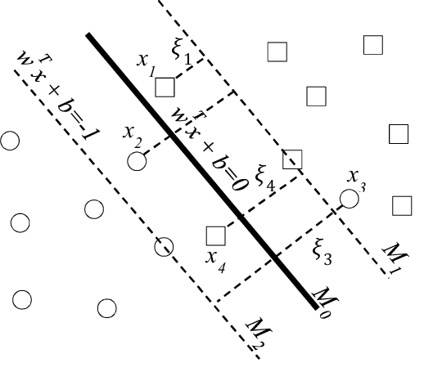
Handling misclassification
Dataset is almost linearly separable
Our current model (Hard-margin SVM) will never be able to solve this problem as it’ll eventually say there’s no w and b that satisfies this.

Slide 11
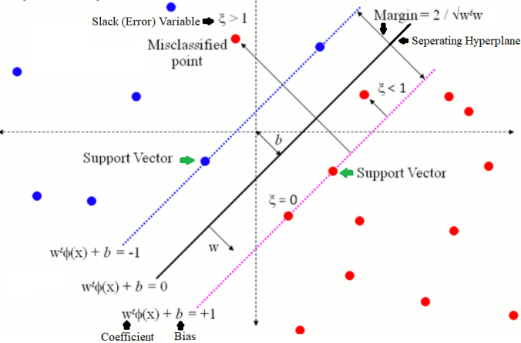
Soft-margin SVM

Slide 12
Making SVM work in almost linearly separable cases
If the dataset is noisy (with some overlap in positive and negative samples), there will be some error in classifying them with the hyper-plane.
In the latter case the objective will be to minimize the errors in classification along with maximizing the margin and the problem becomes a soft-margin SVM (as opposed to the hard margin SVM without slack variables).
A slack variable per training point is introduced to include the classification errors (for the miss-classified points in the training dataset) in the objective, this can also be thought of adding regularization.

Slide 13
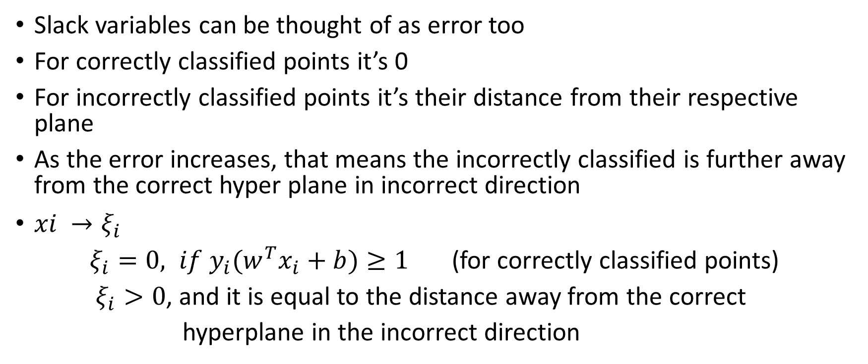
Slack variables can be thought of as error too
For correctly classified points it’s 0
For incorrectly classified points it’s their distance from their respective plane
As the error increases, that means the incorrectly classified is further away from the correct hyper plane in incorrect direction
$xi →ξ_{i}$
$ξ_{i}=0, if y_{i}(w^{T}x_{i}+b)≥1$ (for correctly classified points)
$ξ_{i}>0$, and it is equal to the distance away from the correct
hyperplane in the incorrect direction

Slide 14
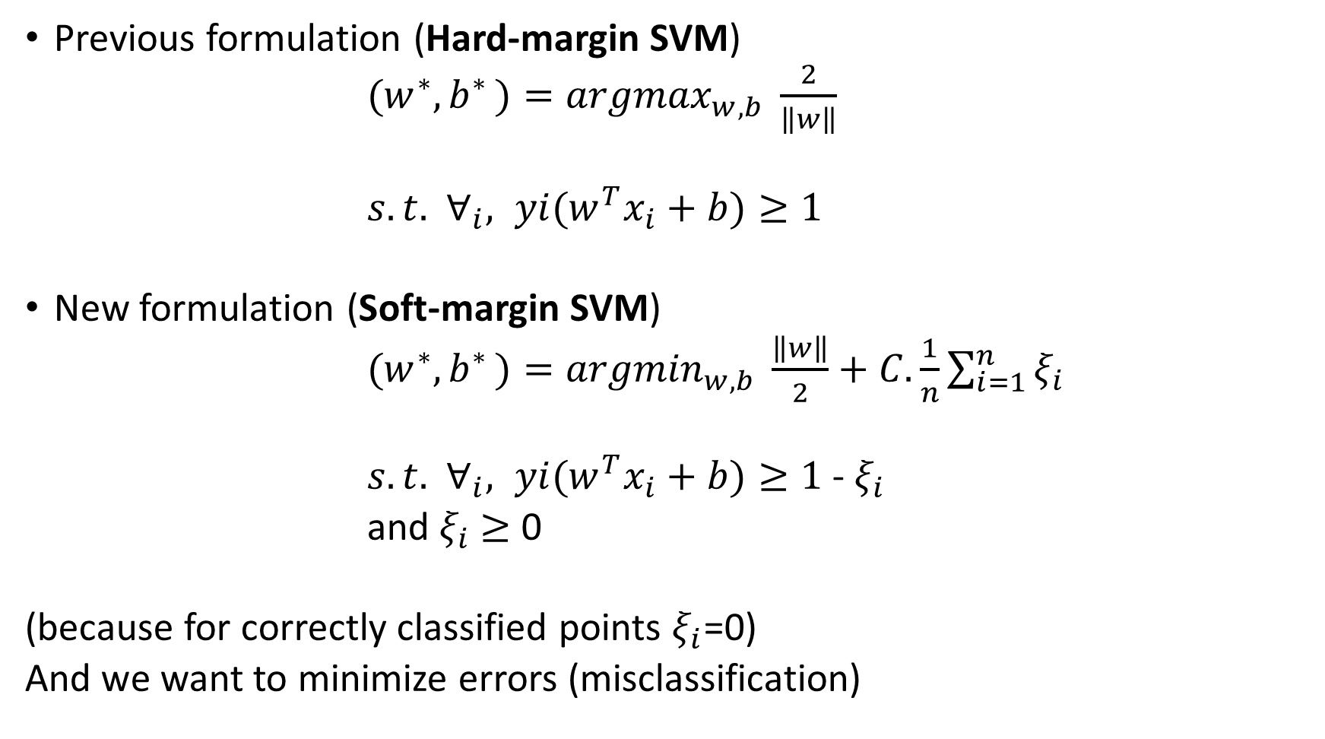
Previous formulation (Hard-margin SVM)
${(w}^{∗}{,b}^{∗})={argmax}_{w,b} \frac{2}{\left\|w\right\|}$
$s.t. { ∀}_{i}, yi{(w}^{T}x_{i}+b)≥1$
New formulation (Soft-margin SVM)
${(w}^{∗}{,b}^{∗})={argmin}_{w,b} \frac{\left\|w\right\|}{2}+C.\frac{1}{n}\sum_{i=1}^{n}{ξ_{i}}$
$s.t. { ∀}_{i}, yi{(w}^{T}x_{i}+b)≥1$ - $ξ_{i}$
and $ξ_{i}$ $≥$ 0
(because for correctly classified points $ξ_{i}$=0)
And we want to minimize errors (misclassification)

Slide 15
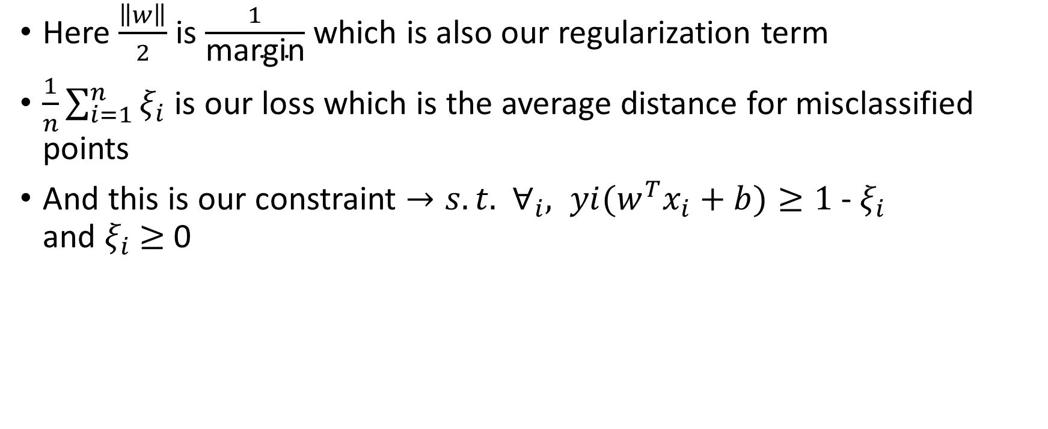
Here $\frac{\left\|w\right\|}{2}$ is $\frac{1}{\text{margin}}$ which is also our regularization term
$\frac{1}{n}\sum_{i=1}^{n}{ξ_{i}}$ is our loss which is the average distance for misclassified points
And this is our constraint $→s.t. { ∀}_{i}, yi{(w}^{T}x_{i}+b)≥1$ - $ξ_{i}$ and $ξ_{i}$ $≥$ 0

Slide 16

$C↑, Errors↓\left(tendency to make mistakes\right)$
If C is too high it’ll overfit (high-variance)
If C is too low, errors will increase and it’ll underfit
C is the hyper parameter (high bias)

Slide 17
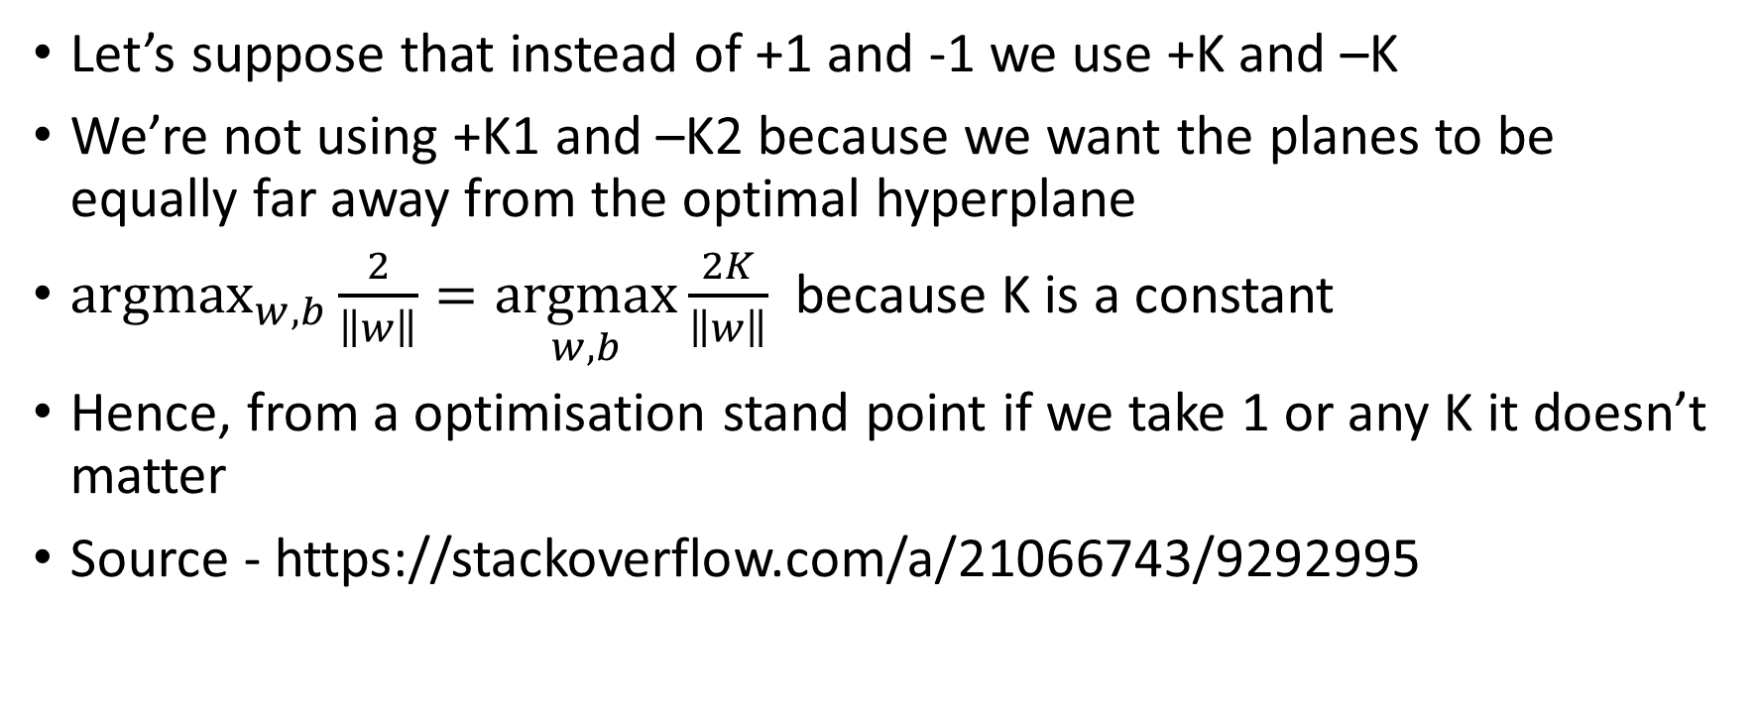
WHY WE TAKE +1 AND -1 FOR SUPPORT VECTOR PLANES
Let’s suppose that instead of +1 and -1 we use +K and –K
We’re not using +K1 and –K2 because we want the planes to be equally far away from the optimal hyperplane
$\underset{w,b}{argmax}{\frac{2}{\left\|w\right\|}}=\underset{w,b}{argmax}{\frac{2K}{\left\|w\right\|} }$ because K is a constant
Hence, from a optimisation stand point if we take 1 or any K it doesn’t matter
Source - https://stackoverflow.com/a/21066743/9292995

Slide 18
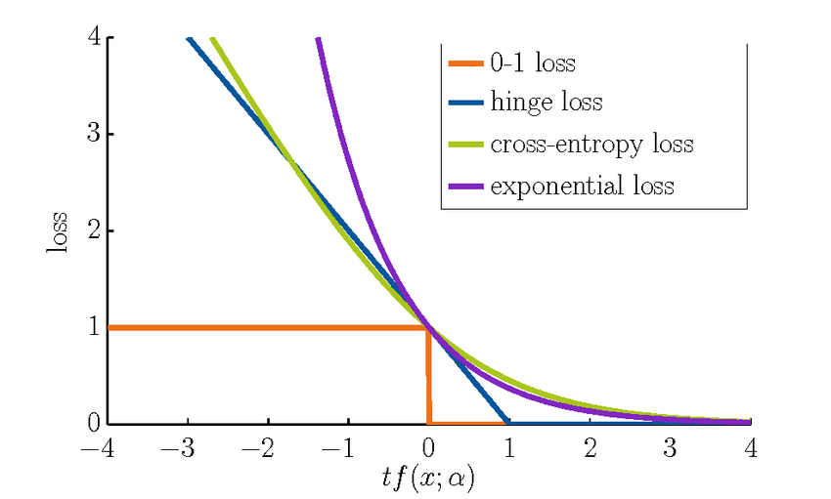
Hinge loss
Logistic regression
Logistic loss + regularization
Linear regression
Linear loss + regularization
SVM
Hinge loss + regularization

Slide 19

Hinge loss behaviour
$yi{(w}^{T}x_{i}+b)$ $≥$ 1, hinge loss = 0
$yi{(w}^{T}x_{i}+b)$ $<$ 1, hinge loss = 1 - $yi{(w}^{T}x_{i}+b)$
Or we can also write it as max(0, 1 - $yi{(w}^{T}x_{i}+b)$ )

Slide 20
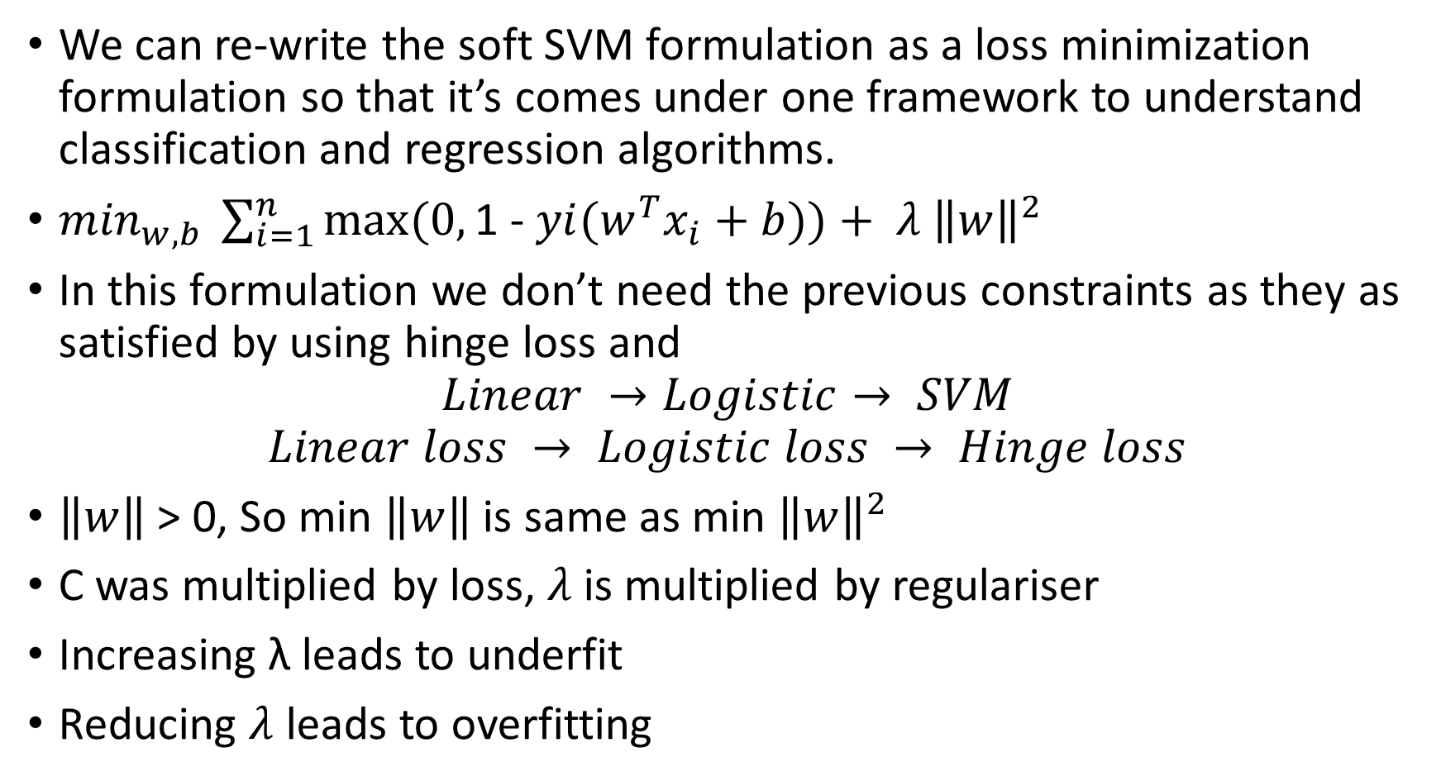
We can re-write the soft SVM formulation as a loss minimization formulation so that it’s comes under one framework to understand classification and regression algorithms.
$\min_{w,b} \sum_{i=1}^{n}{max⁡(0, \text{1 − }yi{(w}^{T}x_{i}+b))+ λ {\left\|w\right\|}^{2}}$
In this formulation we don’t need the previous constraints as they as satisfied by using hinge loss and
$$Linear →Logistic→ SVM$$
$$Linear loss → Logistic loss → Hinge loss$$
$\left\|w\right\|$ > 0, So min $\left\|w\right\|$ is same as min ${\left\|w\right\|}^{2}$
C was multiplied by loss, $λ$ is multiplied by regulariser
Increasing λ leads to underfit
Reducing $λ$ leads to overfitting

Slide 21
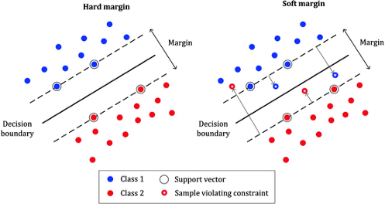

Slide 22
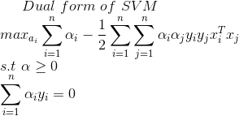

Dual form of SVM
Soft-margin SVM
$${(w}^{∗}{,b}^{∗})={argmin}_{w,b} \frac{\left\|w\right\|}{2}+C.\frac{1}{n}\sum_{i=1}^{n}{ξ_{i}}$$
$s.t. { ∀}_{i}, yi{(w}^{T}x_{i}+b)≥1$ - $ξ_{i}$
and $ξ_{i}$ $≥$ 0

Slide 23

Rules for dual form
$x_{i} → α_{i}$
$x_{i^{′}s}$ occur only in the form of ${x_{i}}^{T}x_{j}$
f($x_{q})$ = $\sum_{i=1}^{n}{α_{i}y_{i}}$ ${x_{i}}^{T}x_{j}+b$ where f(xq) = ${(w}^{T}x_{i}+b$)
$α_{i}$ $>0 for support vectors$

Slide 24
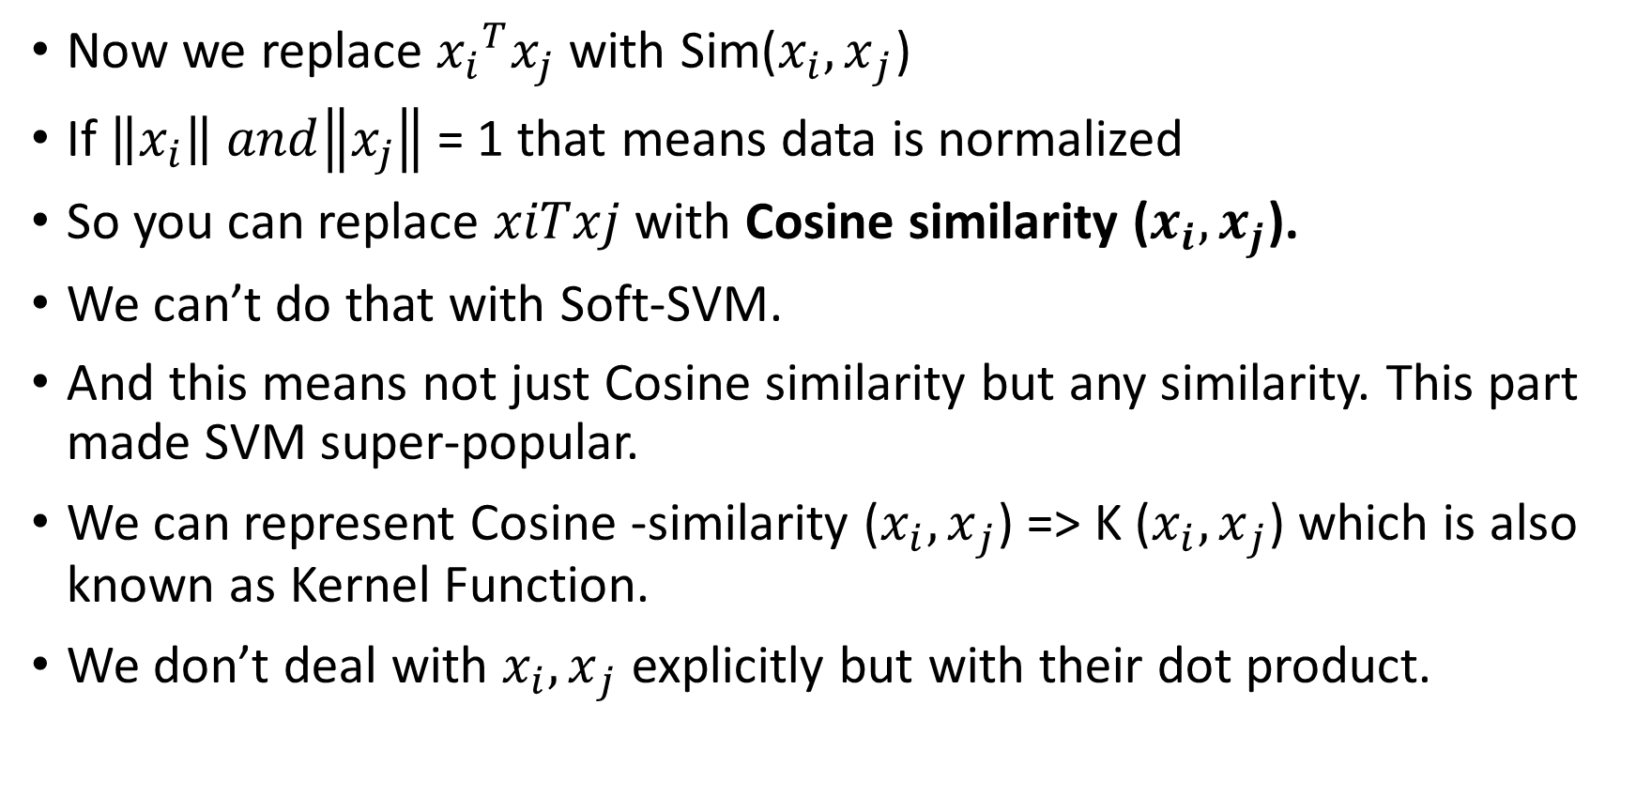
Now we replace ${x_{i}}^{T}x_{j}$ with Sim(${x_{i},x}_{j}$)
If $\left\|x_{i}\right\| and\left\|x_{j}\right\|$ = 1 that means data is normalized
So you can replace $xiTxj$ with Cosine similarity (${x_{i},x}_{j}$).
We can’t do that with Soft-SVM.
And this means not just Cosine similarity but any similarity. This part made SVM super-popular.
We can represent Cosine -similarity (${x_{i},x}_{j}$) => K (${x_{i},x}_{j}$) which is also known as Kernel Function.
We don’t deal with ${x_{i},x}_{j}$ explicitly but with their dot product.

Slide 25
Changing Non-support vectors does not changes the way SVM behaves
The only points that matter are Support vectors

Slide 26
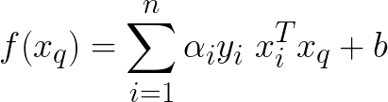
Run-time
The earlier formula that we discussed was for training time
This is what we use to classify variables during runtime

Slide 27
Kernel trick
Now you must be thinking why we are doing this primal to dual form and why no one does this for Logistic regression?
Because when people discovered that by going from primal to dual we have the dot product form of similarity matrix we can use something called as Kernalization or kernel trick.
Kernel trick is the most important idea in SVM, because uptil now whatever we saw (Soft-margin SVM) very similar to Logistic regression + margin maximization.
Without the kernel trick, it’s called Linear SVM

Slide 28
Why Kernel trick?
But till now everything is fine, but did you feel something in mind like, instead of using kernel trick at time of optimization why can’t we transform out input data points into higher dimension and then use soft-margin classification to predict the classes??? can we do this??
Yes we can do something like that, but here is a catch, if you transform whole input data into higher dimension data then you guys need lots of space and computational cost will increase many fold as compared to kernel trick. so that’s why we use kernel trick during optimization process.

Slide 29
Kernel SVM
In Linear-SVM and logistic regression we work in the space of xi’s.
The first maximizes margin hyperplane, the latter minimizes logistic loss
Using kernel SVM we can solve non-linearly separable datasets also
It made SVM popular in 1990’s and early 2000
Kernel trick is extended to LR also, but it is mostly used with SVM’s

Slide 30
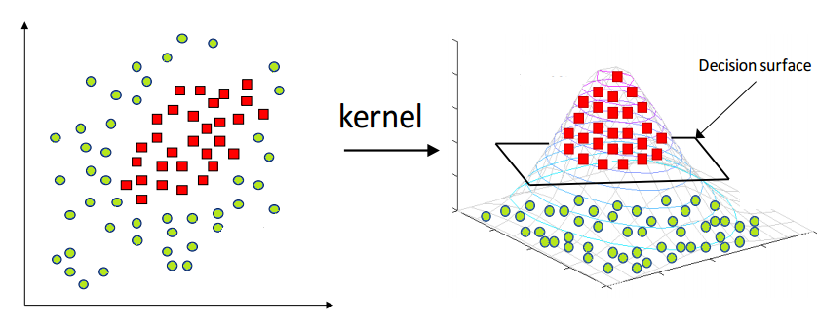
In such a case a linear SVM and logistic regression would fail
Logistic regression with feature transforms would succeed
And SVM with right kernel would succeed too
So, kernel SVM works for non-linearly seperable datasets
A question to ask is what’s the similarity & differences between feature transforms and kernel trick

Slide 31
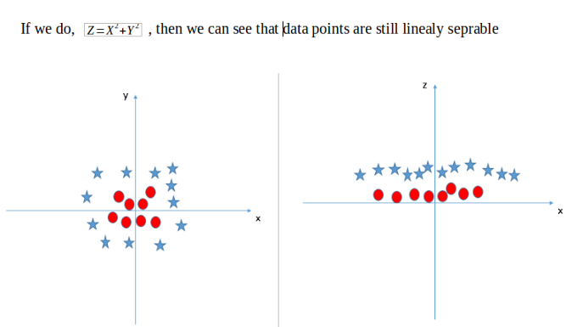

Slide 32
Kernel trick does implicit feature transformation
E.g.- changing from 2-D to 6-D using polynomial kernel for degree 2
The challenge is which kernel to select?
So, we’ve replaced explicit Feature Transform in Logistic regression with finding the right kernel for SVM
Polynomial and exponential kernels calculates separation line in higher dimension. This is called kernel trick

Slide 33
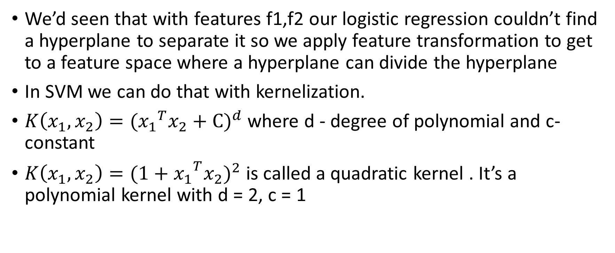
Polynomial Kernel
We’d seen that with features f1,f2 our logistic regression couldn’t find a hyperplane to separate it so we apply feature transformation to get to a feature space where a hyperplane can divide the hyperplane
In SVM we can do that with kernelization.
$K\left(x_{1},x_{2}\right)={({x_{1}}^{T}x_{2}+C)}^{d}$where d - degree of polynomial and c- constant
$K\left(x_{1},x_{2}\right)={({{1+x}_{1}}^{T}x_{2})}^{2}$is called a quadratic kernel . It’s a polynomial kernel with d = 2, c = 1

Slide 34
RBF Kernel
It is a general-purpose kernel; used when there is no prior knowledge about the data. Equation is:
For Gaussian radial basis function (RBF)
Sometimes parametrized using:
Introduce Kernel functions for sequence data, graphs, text, images, as well as vectors. The most used type of kernel function is RBF. Because it has localized and finite response along the entire x-axis.

Slide 35
SVM for Regression
Support Vector Machine can also be used as a regression method, maintaining all the main features that characterize the algorithm (maximal margin). The Support Vector Regression (SVR) uses the same principles as the SVM for classification, with only a few minor differences.
First of all, because output is a real number it becomes very difficult to predict the information at hand, which has infinite possibilities. In the case of regression, a margin of tolerance (epsilon) is set in approximation to the SVM which would have already requested from the problem. But besides this fact, there is also a more complicated reason, the algorithm is more complicated therefore to be taken in consideration.
However, the main idea is always the same: to minimize error, individualizing the hyperplane which maximizes the margin, keeping in mind that part of the error is tolerated.

Slide 36
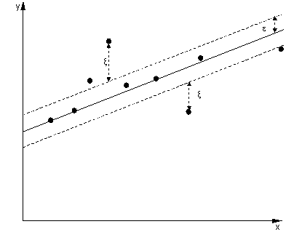
In the same way as with classification approach there is motivation to seek and optimize the generalization bounds given for regression. They relied on defining the loss function that ignores errors, which are situated within the certain distance of the true value. This type of function is often called – epsilon intensive – loss function. The figure here shows an example of one-dimensional linear regression function with – epsilon intensive – band. The variables measure the cost of the errors on the training points. These are zero for all points that are inside the band.

Slide 37
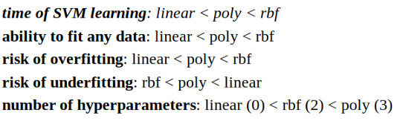
Small comparison of all the above kernel,
It is always recommended to use as simple model as you can, only go for complex model like kernel trick if required.

